Slide 1
PGCE History Mentors’ Meeting October 2022

Slide 2
2022-23: so far, so good!
Induction Week 12th September – 20 trainees (14 Core and 6 SD)
Trainees in school Tuesday and Thursday from 20th September to 20th October – Assignment One
Placement One Block One: Tuesday 1st November to Friday 9th December – Review One
About 12 full and deliberate lessons – lots of other parts – more observations – reading for Assignment Two – subject knowledge work – teacher talk peer project – extracurricular work - mentor-trainee shared reading
Placement One Block Two from Monday 9th January to Friday 3rd February – Assignment Two and Review Two
work up to 50% timetable - subject knowledge work – mentor-trainee shared reading – Assignment Two
Visits to Placement Two School: Tuesday 7th and Thursday 9th February
Notes:
Will of course repeat this across year – are the regular weekly mails from me helpful in terms of right info, right time, right length??
How has Pebblepad worked?
Please remember:
You have a crucial role in drawing them back to what they have learnt in first part of course re history, and in developing reflection. P1 shared reading and P2 discussion topics are part of that
Detailed lessons plan and evaluation in P1 Block 1. If they are flying can then start to see if can internalise planning, but if in any doubt, or a new class then use the written plans. (Let’s keep a trainee specific and responsive approach. – Never listen to ‘but univ says…’!)
Subject specific targets
Chance to mark and give feedback – including ghost marking GCSE/A level in P1
A level experience – must be in P1 if you are an 11-18 school
As much in department and local network activities as you can (YorkClio, Nerds etc)
Note re paired placements (as opposed to two trainees in dept) – trainees some solo classes and some classes they work as a team together to teach (the Y model) – they can observe each other, collaboratively teach/plan/assess/develop resources, work cross-cirrucular. Can teach with 1 as lead and other as TA, or team teach, or split class, offer 1:1 to pupils, specific work with higher/lower attainers, , support each other’s subject knowledge, building prof relationships etc.

Slide 3
Trainee-mentor P1 shared reading
‘Unpicking the Threads of interpretations: tangling up Year 8 in the mess of world views on Oliver Cromwell’ by Dan Keates in TH 179, June 2020.
Let’s play Supermarket ‘Evidential’ Sweep: developing students’ awareness of the need to select evidence. Rachel Foster and Sarah Gadd p24-29 in Teaching History 152
‘Modelling the Discipline: how can Yasmin Khan’s use of evidence enable us to teach a more global World War II?’ p8-15 in Teaching History 177 (Dec 2019)
What do we want students to do with historical change and continuity? Christine Counsell, Chapter 9 of Debates in History Teaching (1st ed.) ed. Davies, I. Routledge 2011
Changing thinking about cause: focusing on change and continuity to refine students’ causal thinking at GCSE Alex Ford in p44-54 in TH178
https://jcarrollhistory.com/2018/02/09/another-reason-why-some-writing-frames-stunt-students-historical-causal-arguments/
Historical consciousness in sixth-form students by Marina Instone and written in 2013 in TH152.
Notes:
January onwards – and early signs are that everything is oddly fixated around the Core Content Framework. On the one hand we are told it is just part of ITE and that it is not an assessment model, on the other hand, all the Ofsted teams this term have fixated on it. Although QTS is gained by assessment vs the Teachers’ Standards, inspectors this term have been suggesting that they should not be mentioned until the end!
I have sent you the CCF on the e-mail. When we get the call, please scan it. And above all, have confidence. Ruth and I have been working with it for over a year now and we are convinced we are doing everything, so please don’t be alarmed, but do be au fait with it.
G-Doc: https://docs.google.com/document/d/1A5TUhn2XG0fPUgUkFtB0mEKwHpraRJpRZGQtXcexlfI/edit

Slide 4
Some news from the ITE world
Turbulence and trickiness!
12 universities and 27 SCITTs not reaccredited to be ITE providers
On paper c5000 teacher training places lost
Some new untested providers of ITE into the ‘market’
Recruitment 2021-22 20% down on 2019 in secondary
But history has over-recruited nationally
No bursaries for history
Competitive jobs market – esp locally
Notes:
January onwards – and early signs are that everything is oddly fixated around the Core Content Framework. On the one hand we are told it is just part of ITE and that it is not an assessment model, on the other hand, all the Ofsted teams this term have fixated on it. Although QTS is gained by assessment vs the Teachers’ Standards, inspectors this term have been suggesting that they should not be mentioned until the end!
I have sent you the CCF on the e-mail. When we get the call, please scan it. And above all, have confidence. Ruth and I have been working with it for over a year now and we are convinced we are doing everything, so please don’t be alarmed, but do be au fait with it.
G-Doc: https://docs.google.com/document/d/1A5TUhn2XG0fPUgUkFtB0mEKwHpraRJpRZGQtXcexlfI/edit

Slide 5
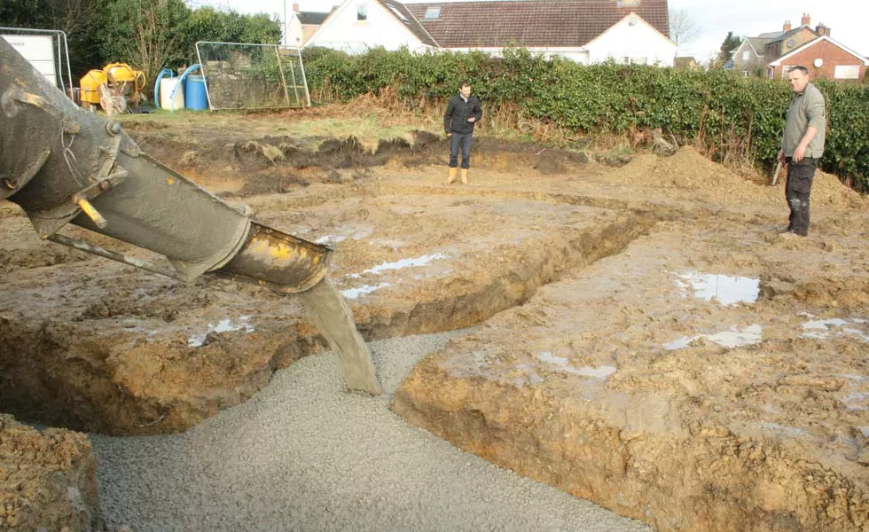
Block One: laying the foundations of professional practice
Discussion:
How do we plan a lesson?
How do we adapt another’s planned lesson?
Notes:
January onwards – and early signs are that everything is oddly fixated around the Core Content Framework. On the one hand we are told it is just part of ITE and that it is not an assessment model, on the other hand, all the Ofsted teams this term have fixated on it. Although QTS is gained by assessment vs the Teachers’ Standards, inspectors this term have been suggesting that they should not be mentioned until the end!
I have sent you the CCF on the e-mail. When we get the call, please scan it. And above all, have confidence. Ruth and I have been working with it for over a year now and we are convinced we are doing everything, so please don’t be alarmed, but do be au fait with it.
G-Doc: https://docs.google.com/document/d/1A5TUhn2XG0fPUgUkFtB0mEKwHpraRJpRZGQtXcexlfI/edit

Slide 6
What does it mean to know history?
To know that the past (people and events) and history (accounts of people and events) are different
To know how to think and write about the past in a disciplined way
To be concerned with evidential thinking and truth – know how we know what we know
To use and create, not just memorise and recall, knowledge
To know how to frame knowledge to reason and argue
To know how to test and contest the historical claims of others
Notes:
January onwards – and early signs are that everything is oddly fixated around the Core Content Framework. On the one hand we are told it is just part of ITE and that it is not an assessment model, on the other hand, all the Ofsted teams this term have fixated on it. Although QTS is gained by assessment vs the Teachers’ Standards, inspectors this term have been suggesting that they should not be mentioned until the end!
I have sent you the CCF on the e-mail. When we get the call, please scan it. And above all, have confidence. Ruth and I have been working with it for over a year now and we are convinced we are doing everything, so please don’t be alarmed, but do be au fait with it.
G-Doc: https://docs.google.com/document/d/1A5TUhn2XG0fPUgUkFtB0mEKwHpraRJpRZGQtXcexlfI/edit

Slide 7
Avoiding anatomisation of the discipline
There is no wrong answer!
Eye witnesses are more reliable!
Sources and evidence are the same thing
If only we can be ‘good enough’ historians we will get to the final account.
Notes:
January onwards – and early signs are that everything is oddly fixated around the Core Content Framework. On the one hand we are told it is just part of ITE and that it is not an assessment model, on the other hand, all the Ofsted teams this term have fixated on it. Although QTS is gained by assessment vs the Teachers’ Standards, inspectors this term have been suggesting that they should not be mentioned until the end!
I have sent you the CCF on the e-mail. When we get the call, please scan it. And above all, have confidence. Ruth and I have been working with it for over a year now and we are convinced we are doing everything, so please don’t be alarmed, but do be au fait with it.
G-Doc: https://docs.google.com/document/d/1A5TUhn2XG0fPUgUkFtB0mEKwHpraRJpRZGQtXcexlfI/edit

Slide 8
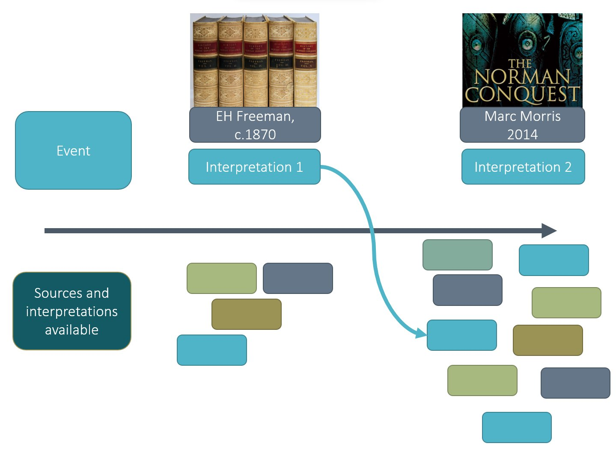
Novice historians (students) often think…
"This interpretation is less accurate as it was
written a long time after the event”
"This source is accurate because
they were there at the time"
Notes:
January onwards – and early signs are that everything is oddly fixated around the Core Content Framework. On the one hand we are told it is just part of ITE and that it is not an assessment model, on the other hand, all the Ofsted teams this term have fixated on it. Although QTS is gained by assessment vs the Teachers’ Standards, inspectors this term have been suggesting that they should not be mentioned until the end!
I have sent you the CCF on the e-mail. When we get the call, please scan it. And above all, have confidence. Ruth and I have been working with it for over a year now and we are convinced we are doing everything, so please don’t be alarmed, but do be au fait with it.
G-Doc: https://docs.google.com/document/d/1A5TUhn2XG0fPUgUkFtB0mEKwHpraRJpRZGQtXcexlfI/edit

Slide 9
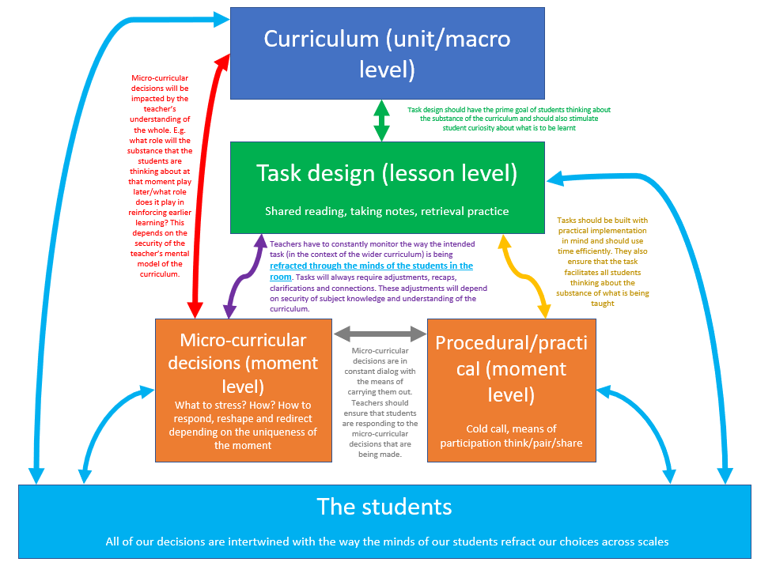
And novice teachers struggle with the micro-curricular decisions…
Notes:
January onwards – and early signs are that everything is oddly fixated around the Core Content Framework. On the one hand we are told it is just part of ITE and that it is not an assessment model, on the other hand, all the Ofsted teams this term have fixated on it. Although QTS is gained by assessment vs the Teachers’ Standards, inspectors this term have been suggesting that they should not be mentioned until the end!
I have sent you the CCF on the e-mail. When we get the call, please scan it. And above all, have confidence. Ruth and I have been working with it for over a year now and we are convinced we are doing everything, so please don’t be alarmed, but do be au fait with it.
G-Doc: https://docs.google.com/document/d/1A5TUhn2XG0fPUgUkFtB0mEKwHpraRJpRZGQtXcexlfI/edit

Slide 10
From the history teaching world
If spot trainee ‘gaps’ need help to fill: https://www.history.org.uk/secondary/categories/380/module/8763/teaching-for-beginners
Historical Anniversaries calendar: https://www.history.org.uk/secondary/resource/9676/historical-anniversaries-calendar
HA Great Debate – local round 6pm Monday 30 January: https://www.history.org.uk/secondary/categories/514/news/3886/the-great-debate-2023
Be Bold History Network history CPD films: https://www.youtube.com/channel/UCYFJlVFdSpd-N69KU02oo7g
Updated Historical Fiction list: https://www.history.org.uk/secondary/categories/404/news/3700/historical-fiction-list
GRT history resources via YorkClio: https://yorkclio.com/2022/05/13/teaching-gypsy-roma-and-traveller-history/
Early Career Development Programme: https://www.history.org.uk/secondary/module/8813/early-career-development-programme
Notes:
January onwards – and early signs are that everything is oddly fixated around the Core Content Framework. On the one hand we are told it is just part of ITE and that it is not an assessment model, on the other hand, all the Ofsted teams this term have fixated on it. Although QTS is gained by assessment vs the Teachers’ Standards, inspectors this term have been suggesting that they should not be mentioned until the end!
I have sent you the CCF on the e-mail. When we get the call, please scan it. And above all, have confidence. Ruth and I have been working with it for over a year now and we are convinced we are doing everything, so please don’t be alarmed, but do be au fait with it.
G-Doc: https://docs.google.com/document/d/1A5TUhn2XG0fPUgUkFtB0mEKwHpraRJpRZGQtXcexlfI/edit

Slide 11
Links from the chat
The observation forms: https://www.york.ac.uk/education/pgce/trainees/forms/
The shared reading: https://docs.google.com/document/d/1NnIc7oRcoc0OFMOQifZp0i76PycaW7noQT04SMAYk_I/edit#heading=h.gjdgxs
The Beginning Teacher RAG rating doc that has links to the HA site alongside problem areas identified – and also to the CCF/ECF parts: https://www.history.org.uk/secondary/categories/380/module/8767/beginning-teachers-professional-learning/10363/312-support-in-the-first-history-teaching-post

